Slide 1



“Personal Diary Management System”

Slide 2
Table of contents
01.
Introduction
05.
Encrypt/Decrypt
02.
Add New Entry
06.
Backup System
03.
View & Search
07.
Walkthrough
04.
Edit & Delete
08.
Our Team

Slide 3



01. Introduction
Overview:
PDMS is a secure digital diary application. Console-based application for personal diary management system.
Features:
Add new diary entries with dates
View all entries or search by date
Edit existing entries
Delete unwanted entries
Secure encryption with password protection
Automatic timestamped backups

Slide 4




02. Add New Entry
Functionality:
Appends new entries to "diary.txt" file
Stores both date and entry content
User-friendly prompts
Error handling for file operations
Clear success message after saving

Slide 5
03. View & Search Entries
View All Entries:
Reads and displays entire diary file
Formatting for better readability
Search Entries:
Linear search through file contents
Clear indication when no matches found
Displays complete matching entries

Slide 6

04. Edit & Delete
Functionality:
Finds entry by date
Allows modifying entry text
Uses temporary file for safe updates
File handling with error checking
User confirmation before changes

Slide 7


05. Encrypt and Decrypt Diary File
Security Features:
XOR-based encryption with password
Password length verification
Header validation
Decryption Safety Checks:
Password length matching
Content structure verification
Temporary memory decryption

Slide 8

06. Backup System
Backup Functionality:
Creates timestamped copies
Automatic filename generation
Benefits:
Data protection against accidental loss
Historical record of entries
Simple file copy operation

Slide 9
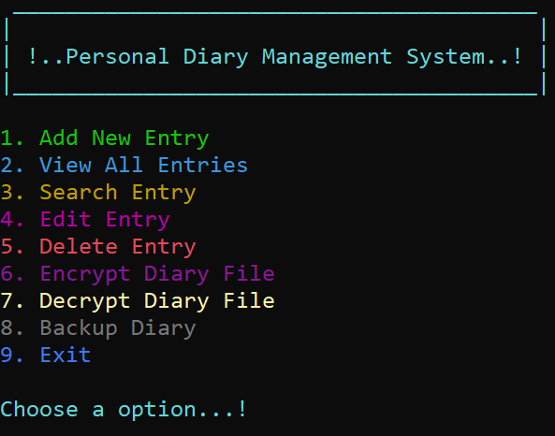
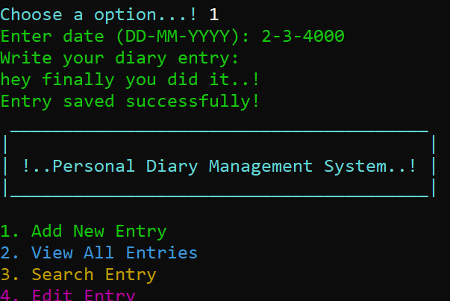
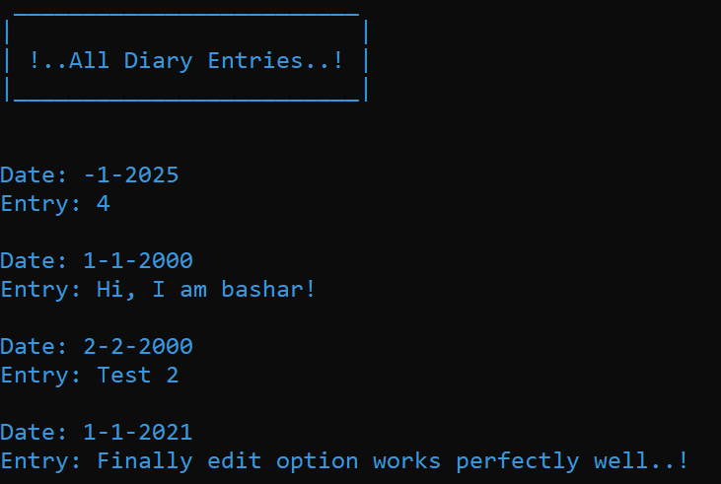
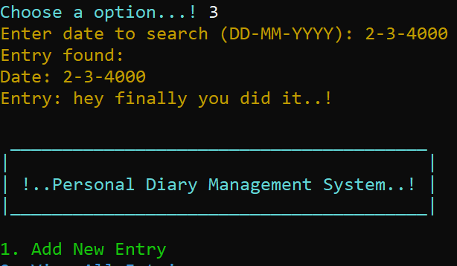
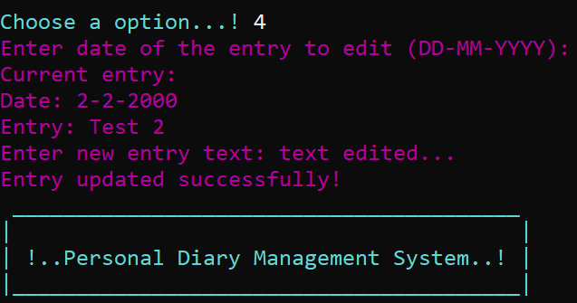
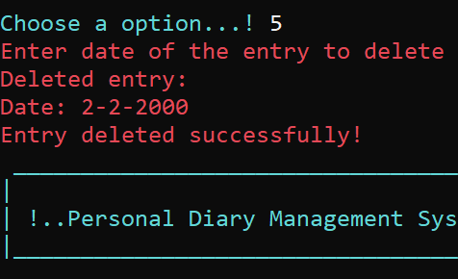
07. Git-Hub Walkthrough
User Interface:
Different colors functions
Clear visual hierarchy
Menu Options:
Add New Entry
View All Entries
Search Entry
Edit Entry
Delete Entry
Encrypt Diary
Decrypt Diary
Exit

Slide 10


08. Our Team!
01.
Md Abul Bashar Nirob - 2022198042
02.
Jannatul Islam Eshita - 2524186042
03.
Tashin Binte Taiba - 252 2283 642
04.
Sara Tasnim - 2522727042
05.
Tasnia Afrin - 2523855642

Slide 11
“Thanks..!”

